Slide 1
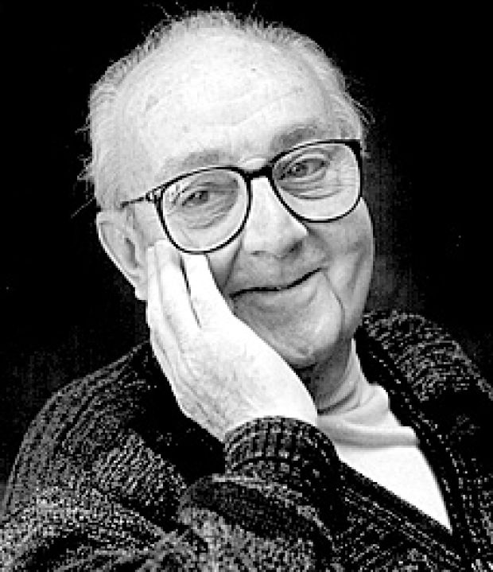
Classification and Regression Trees (CART) and
Random Forests
“Just as the ability to devise simple but evocative models is the signature of the great scientist so overelaboration and overparameterization is often the mark of mediocrity”- George E. P. Box, 1976

Slide 2
Machine Learning Methods
Completely different in flavor than parametric classical statistical inference
Often borrowing ideas from computer science and engineering where characterizing uncertainty is de-emphasized, more algorithmic than stochastic
Learn from the data as opposed to cast the data into a linear/structured model

Slide 3
Supervised Learning Setup
Output measurement Y (also called class label, response, dependent variable, target).
Vector of p input measurements X (also called predictors, regressors, covariates, independent variables, features).
Y takes values in a finite, unordered set (binary: alive / dead, continuous measure: blood lead).
We have training data (y₁, x₁),…. (y_{n}, x_{n}). These are observations (instances) of these measurements.

Slide 4
Objectives
On the basis of the training data we would like to
  Accurately predict unseen test cases
  Understand which inputs affect the output, and how
  Assess the quality of our predictions and inferences

Slide 5
General Tree-based methods
Prediction, classification and assessment of variable importance are critical questions in statistical inference.
Recursive partitioning is a general strategy where the feature space (e.g. space spanned by all 20 predictor variables in NHANES) is split into regions containing observations with similar response values.

Slide 6
Classification vs Regression
Classification Tree: When Y (outcome) is binary/unordered categorical, you want to assign each subject to a category Y=k, Error assessment through misclassification cost.
Regression Tree: Y is continuous or ordered discrete values. Prediction error measured by squared or relative absolute difference between observed and predicted values.

Slide 7
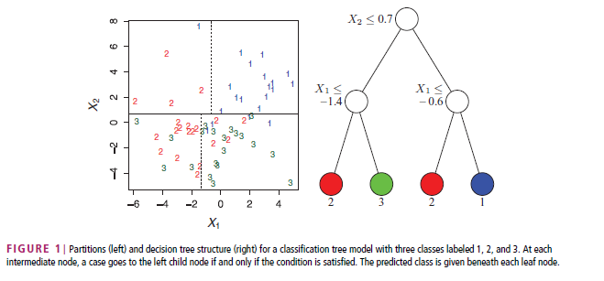
Classification Tree: 3 class labels, two predictors, partition
X space (feature space) into rectangular sets
Loh et al, 2011

Slide 8
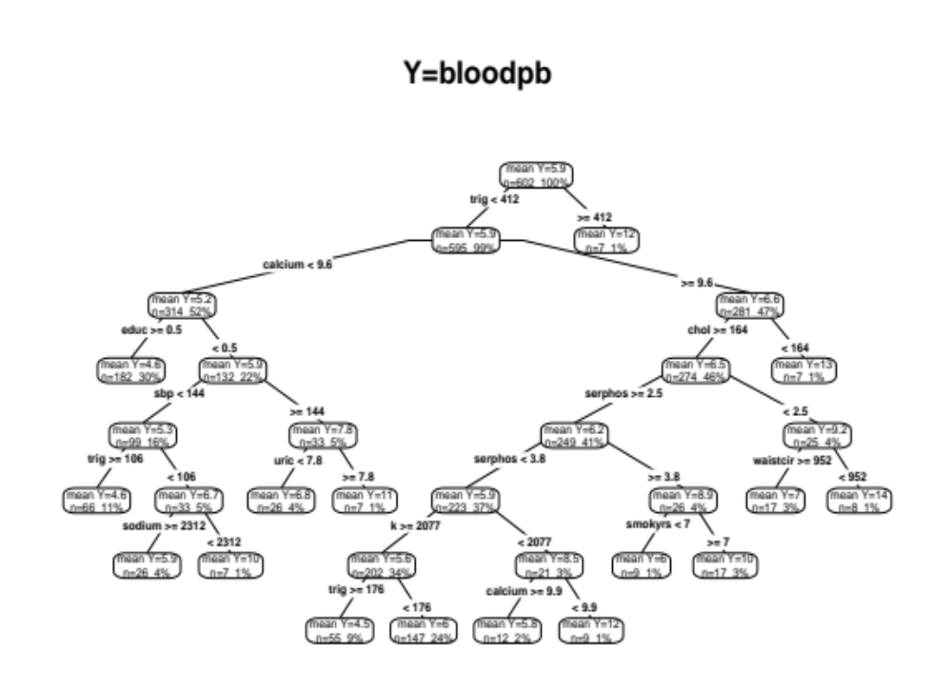
Regression Tree
Prediction by group mean

Slide 9
Classification and Regression Trees
Breiman, Friedman, Olshen and Stone (1984), proposed this 30 years ago.
Feature space recursively partitioned into rectangular areas such that observations with similar responses are grouped together.
When you stop you provide a common prediction for Y for subjects in the same group.

Slide 10
What is the difference with linear regression?
Linear in predictors?
Multiple splits of the same predictor
Non-linear and even non-monotone associations are identified in data-adaptive way.
Interactions are allowed, but the focus is identification of association/variable importance, allowing for interactions.

Slide 11
Why use trees ?
yields relatively simple and easy to comprehend models.
frequently more accurate than parametric tools.
method can sift through any number of variables.
can separate relevant from irrelevant predictors.

Slide 12
Universally applicable to both classification and regression problems with no assumptions on the data structure.
Good properties: variable selection, missing data, mixed predictors.
Picture of the tree gives valuable insights into which variables are important and where.
4. Terminal groups suggest natural clustering of data into homogeneous groups.

Slide 13
CART Biomedical Applications
CART has had an enormous impact in biomedical studies
A large number of cancer and coronary heart disease studies published
Over 1000 publications using CART in last decade
Recently, a growing number of applications in other fields
  Market research
  Credit risk assessment
  Financial markets
Notes:
8

Slide 14
Why is CART receiving more attention ?
Availability of huge data sets requiring analysis
Need to automate or accelerate and improve analysis process
Rising interest in data mining
New software and documentation make techniques accessible to researchers
Next generation CART techniques appear to be even better than former
Notes:
10

Slide 15
Well illustrated with a famous example : the UCSD Heart Disease study
Given the diagnosis of a heart attack based on
  Chest pain, Indicative EKGs, Elevation of enzymes typically released by damaged heart muscle
Predict who is at risk of a 2nd heart attack and early death within 30 days
  Prediction will determine treatment program (intensive care or not)
For each patient about 100 variables were available, including
  demographics, medical history, lab results
  19 noninvasive variables were used in the analysis
Notes:
13

Slide 16
2nd Heart Attack Risk Tree
Example of a CLASSIFICATION tree
Dependent variable is binary (SURVIVE, DEATH)
Want to predict class membership
Trees with a continuous dependent variable are called REGRESSION trees
Notes:
14

Slide 17
<= 91
N = 215
SURVIVE 178 82.8%
> 91
DEAD 37 17.2%
Is BP <= 91 ?
SURVIVE 6 30%
N = 195
DEAD 14 70%
<= 62.5
> 62.5
NODE = DEAD
SURVIVE 172 88.2%
DEAD 23 11.8%
AGE <= 62.5 ?
SURVIVE 102 98.1%
N = 91
DEAD 2 1.9%
YES
SURVIVE 70 76.9%
NO
DEAD 21 23.1%
NODE = SURVIVE
Sinus
Tachycardia ?
SURVIVE 14 46.6%
SURVIVE 56 91.8%
DEAD 16 53.4%
DEAD 5 8.2%
NODE = DEAD
NODE = SURVIVE
Notes:
15
For Terminal node A, only 1 variable alone is enough to know. Not true for logistic regression. You need to know the entire logit.
BP : minimum ystolic blood pressure over the initial 24 hour period
SINUS : sinus: is sinus tachycardia present ? Episode of accelerated heart beat. This is a yes/no variable.

Slide 18
What’s new in this method ?
Entire tree represents a complete analysis or model
Has the form of a decision tree
Root of inverted tree contains all data
Root gives rise to child nodes which in turn can give rise to their own children

Slide 19
At some point a given path ends in a terminal node
Terminal node classifies a subject
Terminal nodes associated with a single class
  any case arriving at a terminal node is assigned to that class
Path through the tree governed by answers to QUESTIONS or RULES

Slide 20
Questions of the form:
Is continuous variable X ≤ c ?
  reports a split value which is the mid-point between two actual data values: better for future data
Does categorical (nominal) variable D take on levels i, j, or k ?
  e.g. Is geographic region 1, 2, 4, or 7 ?
Question is formulated so that only two answers possible
  called binary partitioning
  partitions can also be split into subpartitions : hence procedure is recursive

Slide 21
Accuracy of a Tree
For classification trees
  all objects reaching a terminal node are classified in the same way
    e.g. all heart attack victims with BP > 91 and AGE less than 62.5 are classified as SURVIVORS
  classification is same regardless of other medical history and lab results
Some cases may be misclassified
  R(T) = % of learning sample misclassified in tree T
  R(t) = % of learning sample in node t misclassified
      T identifies a TREE
      t identifies a NODE

Slide 22
Prediction Success Table
CLASSIFIED AS
TRUE | Survive | Dead | Total
Survive | 158 | 20 | 178
Dead | 7 | 30 | 37
Total | 165 | 50 | 215
% correct = 188/215=0.8744
In CART terminology the performance of the tree T is described by the error rate R(T)
  in our example R(T) = 1 – 0.8744 = 0.1256

Slide 23
Example tree exhibits characteristic CART features
Tree is relatively simple : focus is on just 3 variables
  CART trees are normally simple relative to the problem but trees can be very large (50, 200, 500 nodes)
Accuracy is often high : about as good as any logistic regression on more variables
  not easy to develop a parametric model significantly better than a CART tree, unless data exhibits linear structure
Results can be easily explained to non-technical audience
  more enthusiasm from decision makers for CART

Slide 24
Interpretation and use of the TREE
Selection of the most important prognostic variables
  variable screen for parametric model building
  example data set had 100 variables
  use results to find variables to include in a logistic regression model
Insight : in our example age is not relevant if BP is not high
  suggests which interactions will be important

Slide 25
Elements of Tree Construction
Tree growing
  why and how is a parent node split into two daughter nodes ? (splitting rules).
  when do we declare a terminal node ?
Finding the “right-sized” tree
  pruning.
Testing critical to finding honest trees
  external test sets.
  sample reuse : cross-validation.
Trees without test and proper pruning are like regressions without standard errors.
Notes:
Regression trees vs. MARS :
regression trees fit a constant to the response within every terminal node, whereas adaptive splines use piecewise linear functions as the basis functions. The key difference between MARS and CART lies in the fact that the regression function is continuous in MARS with respect to a continuous covariate, but not in CART.
Trees without test and proper pruning are like regressions without standard errors.

Slide 26
Splitting Rules
Key to generating a tree is asking the right question
  is continuous variable X ≤ c ?
  does categorical variable D take on levels i, j, or k ?
Examine ALL possible splits
  computationally intensive but there are only a finite number of splits.
Goodness of candidate splits is evaluated based on an impurity function.
Notes:
Binary questions. More complex questions : Boolean combinations, linear combinations (give rise to oblique splits)
Splitting is strictly myopic (no look ahead) - when splitting a node, it does not care whether this is a root node or intermediate node, etc.
Splitting rules are based on maximizing purity of each daughter node. Concept of node impurity.
For a classification problem : a node which contains members of only one class is perfectly pure, & a node which contains an equal proportion of every class is least pure.
For classification trees, measures of node impurity : Gini, information.
For regression trees : node impurity is the within-node variance of the response.

Slide 27
Tree Growing
Grow tree until further growth is not possible
  result is called MAXIMAL tree.
In practice certain limits can be imposed
  do not attempt to split smaller nodes.
Notes:
Differs from earlier methods such as AID or CHAID on stopping : Do NOT stop tree growth.
In practice certain limits can be imposed : do not split if node size less than 15 (say)

Slide 28
Tree Pruning
Take the maximal tree (radically overfit).
Prune branches from the large tree.
Pruning at a node means making that node terminal by deleting all its descendants.
Challenge is how to prune
  which branch to cut first
  what sequence : there are hundreds, if not thousands of pruning sequences.
Notes:
Take some large tree such as the maximal tree
Tree may be radically overfit
tracks all idiosyncracies of THIS data set
Challenge is how to prune : which branch to cut first, what sequence (there are hundreds if not thousands of pruning sequences)

Slide 29
What makes one splitting rule better than another ?
Extent of homogeneity of the daughter nodes
Quantification in terms of node impurity
  d_{t} : # of YES in a node
  n_{t} : total # of subjects in the node
  ratio p_{t} = d_{t} /n_{t} : closer this ratio is to 0 or 1, the more homogeneous is the node.

Slide 30
Evaluation of splits with the Impurity Function
CART evaluates goodness of any candidate split using an impurity function
A node which contains members of only one class is perfectly pure
  such a node is clearly classifiable (impurity measure=0)
A node which contains an equal proportion of every class is least pure
  no easy way to classify : highly ambiguous
  impurity measure maximum

Slide 31
Many impurity functions to choose from
i(t)= impurity measure of node t
i(t) is a function of p_{t}
  several choices of φ
    Entropy
    Gini
    Minimum error

Slide 32
Goodness of split criterion
Improvement measure is decrease in impurity
  parent node impurity minus weighted average of the impurities in each child node
Impurity function is strictly concave, so ANY split will yield an improvement >= 0

Slide 33
Growing a Tree: Splitting
Fix a predictor
Fix a cut-point for the predictor
Compute within-node probabilities
Compute the impurities of daughter nodes
Compute “Improvement” achieved by split
Repeat for all cut-points and all predictors
Choose Split with the max Improvement

Slide 34
Now that we know how to grow a tree, when do we stop ?
A core CART innovation : don’t stop tree growth
Key to finding the right tree is in the pruning
  major difference from earlier methods
  holds up better on new data
Notes:
Stopping rules were problematic : in going too far along some branches and not going far enough on others

Slide 35
<= 91
N = 215
SURVIVE 178 82.8%
> 91
DEAD 37 17.2%
Is BP <= 91 ?
SURVIVE 6 30%
N = 195
DEAD 14 70%
<= 62.5
> 62.5
NODE = DEAD
SURVIVE 172 88.2%
DEAD 23 11.8%
AGE <= 62.5 ?
SURVIVE 102 98.1%
N = 91
DEAD 2 1.9%
YES
SURVIVE 70 76.9%
NO
DEAD 21 23.1%
NODE = SURVIVE
Sinus
Tachycardia ?
SURVIVE 14 46.6%
SURVIVE 56 91.8%
DEAD 16 53.4%
DEAD 5 8.2%
NODE = DEAD
NODE = SURVIVE
Notes:
15
For Terminal node A, only 1 variable alone is enough to know. Not true for logistic regression. You need to know the entire logit.
BP : minimum ystolic blood pressure over the initial 24 hour period
SINUS : sinus: is sinus tachycardia present ? Episode of accelerated heart beat. This is a yes/no variable.

Slide 36
CART introduced cost-complexity pruning
Begin with a large tree such as the maximal tree (radically overfit)
Pruning at a node means making that node terminal by deleting all its descendants
Point is to find a subtree of the maximal tree that is most “predictive”of the outcome and least vulnerable to the noise in the data

Slide 37
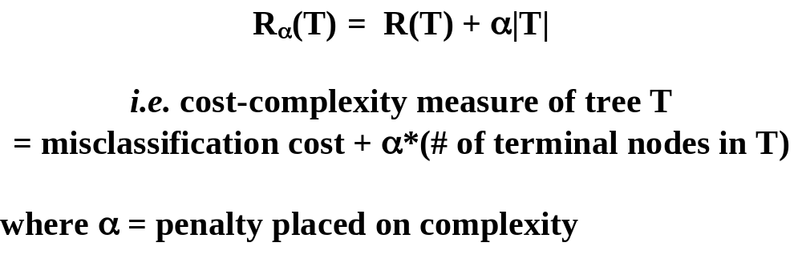
Cost-Complexity Pruning
Use of tree cost-complexity (Breiman et al., 1984) allows us to construct a sequence of nested optimal subtrees from any given tree T for final selection.
Notes:
Thm. 1 For any value of the complexity parameter α, there is a unique smallest subtree of T that minimizes the cost-complexity.
Thm. 2 If α₁ > α₂ , the optimal subtree corresponding to α₁ is a subtree of the optimal subtree corresponding to α₂
Order of pruning : prune away the weakest link

Slide 38
Cost-complexity pruning
Role of α
  α =1 : prefer null tree
  α =0 : prefer largest tree
  higher the α, more you favor smaller trees
Sacrifice the node that contributes least to R_{α}(T)
Notes:
Prune away “weakest link” : the nodes that add least to overall accuracy
If several nodes have same complexity threshold they all prune away simultaneously
Hence more than two terminal nodes could be cut off in one pruning
For any value of the complexity parameter α, there is a unique smallest subtree of T minimizes the cost-complexity.

Slide 39
Cost-complexity pruning
Theorem 1: For any value of the complexity parameter α, there is a unique smallest subtree of the maximal tree that minimizes the cost-complexity.
Theorem 2: If α₁ > α₂ , the optimal subtree corresponding to α₁ is a subtree of the optimal subtree corresponding to α₂ .

Slide 40
Selecting the right-sized tree
Testing critical to finding honest trees
  External test sets when large data volumes available
  Internal cross-validation when data not so plentiful
No way to tell which tree is believable without these tests
Test data set or cross-validation measures the error rate of each tree
Notes:
In CHAID, test data has no role in tree selection. But in CART, test data does play a part in tree selection.
10-fold cross validation is the industry standard

Slide 41
CART will allow variable costs of misclassification
For most classification schemes…..
  “AN ERROR IS AN ERROR IS AN ERROR”
In practical applications different errors are quite different in importance
  misclassifying a malignant breast tumor as benign : possible death of patient
  misclassifying benign as malignant : unnecessary open breast biopsy
Want both classes classified correctly : either mistake serious
May want to up-weight the misclassification of malignant tumors error

Slide 42
Final Tree Selection
Need honest estimates of the misclassification costs of the subtrees.
External test sets when large data volumes available.
Internal cross-validation when data not so plentiful
  10 fold cross-validation : the industry standard.

Slide 43
Drawbacks of CART
INSTABILITchange a lot.
MODEST ACCURACY
  current methods, such as ensemble classifiers often have 30% lower error rates than CART.
INSTABILITY
- if we change the data a little, tree picture can change a lot

Slide 44
Bootstrap Samples
Sample with replacement.
Training data (y₁, x₁),…. (y_{n}, x_{n}).
Randomly draw one, denote as (y₁*, x₁*); make a copy and put it back.
Repeat for n times, then we have (y₁*, x₁*)….. (y_{n}*, x_{n}*). This is called a bootstrap sample.
Repeat everything for B times, then we have B bootstrap samples.

Slide 45
Ensemble Classifiers
Bagging (Breiman 1996): Fit many large trees to bootstrap resampled versions of the training data, and classify by majority vote.
Boosting (Freund & Schapire 1996): Fit many large or small trees to reweighted versions of the training data. Classify by weighted majority vote.

Slide 46
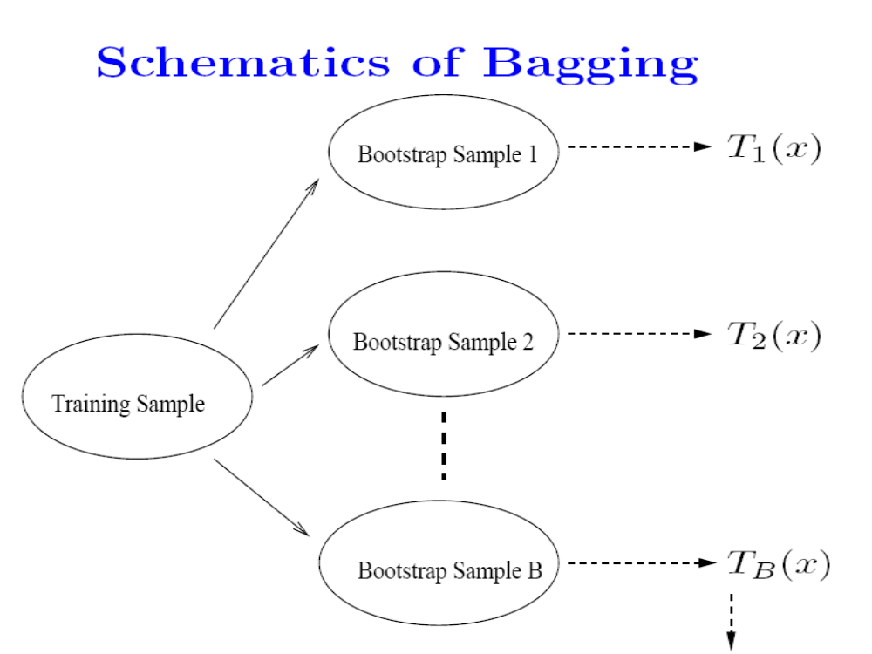

Slide 47
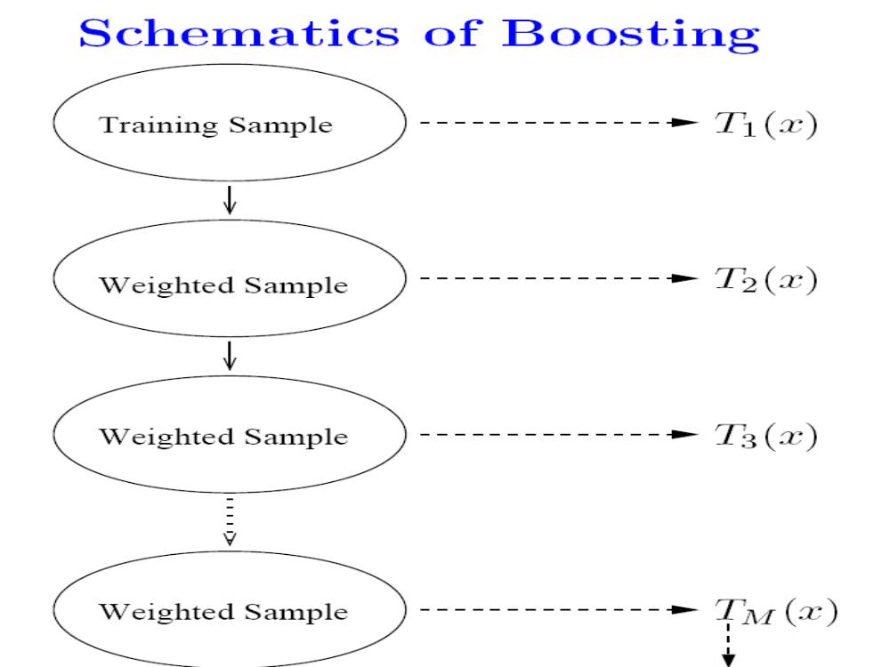

Slide 48
In general,
Boosting > Bagging > Single Tree.

Slide 49
Random Forests
General purpose tool for classification and regression.
Impressive accuracy: about as accurate as support vector machines and neural networks
Capable of handling large datasets
Effectively handles missing values
Gives a wealth of scientifically important insights
A set of trees is a forest.

Slide 50
Out-of-bag data
For each tree in the forest, we select a bootstrap sample from the data.
The bootstrap sample is used to grow the tree.
The remaining data are said to be “out-of-bag” (about 1/3 of the cases)
The out-of-bag (oob) data can serve as a test set for the tree grown on the bootstrap sample.

Slide 51
The oob error estimate
Think of a single case in the training set.
It will be out-of-bag in about 1/3 of the trees.
Each time it is out of bag, pass it down the tree and get a predicted class.
The RF prediction is the class that is chosen the most often.
For each case, the RF prediction is either correct or incorrect
  Average over the cases within each class to get a classwise oob error rate
  Average over all cases to get an overall oob error rate

Slide 52
Out-of-bag data and variable importance
Consider a single tree (fit to a bootstrap sample).
  Use the tree to predict the class of each out-of-bag case.
  Randomly permute the values of the variable of interest in all the out-of-bag cases, and use the tree to predict the class for these perturbed out-of-bag cases.
The variable importance is the increase in the misclassification rate between steps 1 and 2, averaged over all trees in a forest

Slide 53
Tree and Random Forests Resources
RPART (R interface)
RandomForest (R interface: Andy Liaw & Matthew Weiner)
Free, open-source code (fortran, java)
www.stat.berkeley.edu/users/breiman/RandomForests

Slide 54
R implementation
Continuous Y error is RSS
In method=anova, you choose the split that maximizes “between SS” of the two resultant groups
Each group has a prediction equal to the group mean
The error at each node is the variance of y

Slide 55
Variable Importance (in rpart)
Each X can appear multiple times in a tree as primary variables for a split
Also, it can help predict the grouping based on the primary variable if it was missing. “surrogate variable”
VI is a weighted measure of goodness of split for each split where X was a primary variable and for all splits it was a surrogate. (scaled to add up to 100)

Slide 56
library('rpart')
##Grow the tree
set.seed(0) #set up the random-number-generator seed for cross validation (CV)
fit.cart=rpart(y~.,data=dat.nas,method="anova") # anova for y is continuous, the default CV is 10-fold.
summary(fit.cart) #detailed results
fit.cart$cptable# the Complexity parameter (CP)table
CP nsplit rel error xerror xstd
1 0.0362 0 1.000 1.00 0.113
2 0.0268 3 0.891 1.06 0.113
3 0.0244 5 0.838 1.09 0.115
4 0.0216 6 0.813 1.10 0.116
5 0.0161 8 0.770 1.11 0.119
6 0.0137 10 0.738 1.11 0.116
7 0.0120 11 0.725 1.12 0.116
8 0.0120 12 0.712 1.12 0.116
9 0.0109 13 0.701 1.12 0.116
10 0.0107 14 0.690 1.14 0.115
11 0.0100 15 0.679 1.14 0.115

Slide 57
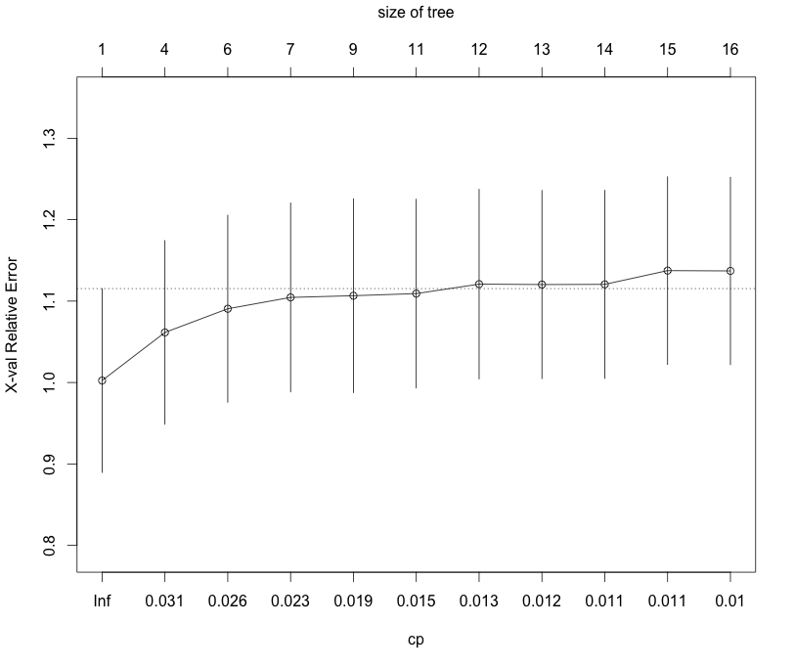
> plotcp(fit.cart) #plot of CP table

Slide 58
> rpart.plot(fit.cart,type=4,extra = 101,prefix="mean Y=",main="Y=bloodpb") #tree plot
Tree corresponding to
Complexity parameter=0.01

Slide 59
vi.cart=fit.cart$variable.importance/sum(fit.cart$variable.importance)*100
#the variable importance, rescaled to add to 100.
vi.cart
trig serphos calcium chol waistcir k
11.440 11.043 10.497 7.679 6.518 4.368
bmi weight sbp uric hdl hipcir
4.214 3.853 3.244 3.134 3.045 2.729
age sodium educ smokyrs
2.704 2.515 2.495 2.334
pp calor packyrs calc_wo smk height
2.307 2.148 2.141 2.083 2.074 1.607
hct wcollar hgb dbp htnfam kcaltot
1.335 1.078 1.050 0.726 0.519 0.321
htn white gluc_fas
0.272 0.266 0.261

Slide 60
> length(vi.cart) # number of variables with non-zero variable importance (VI)
[1] 31
> sum(vi.cart>1) #number of variables with VI>1
[1] 25
(2) Prune the tree
R code:
##Prune the tree
prune.cart = prune(fit.cart, cp= fit.cart$cptable[4, "CP"])# prune the tree
rpart.plot(prune.cart,type=4,extra = 101,prefix="mean Y=",main="Y=bloodpb") #tree plot
vi.prune=prune.cart$variable.importance/sum(prune.cart$variable.importance)*100
#the variable importance, rescaled to add to 100.
vi.prune
length(vi.prune) # number of variables with non-zero variable importance (VI)

Slide 61
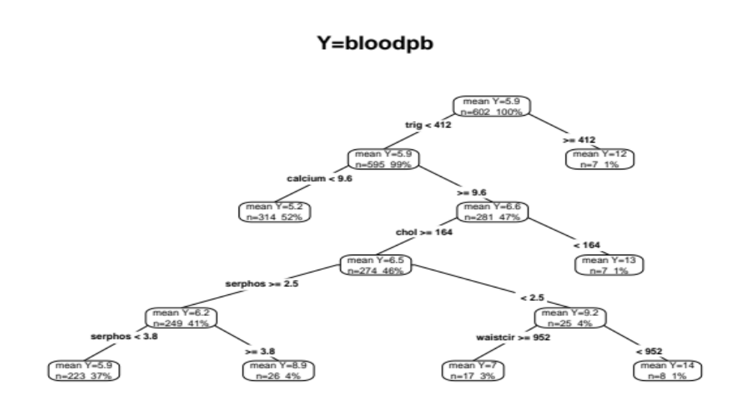
Pruned Tree

Slide 62
> #the variable importance, rescaled to add to 100.
> vi.prune
serphos chol calcium trig waistcir
18.577461 13.578202 12.832810 11.030685 10.370960
weight hipcir bmi hdl age
7.778220 5.508537 5.185480 4.212198 3.889110
hct hgb sodium uric height
2.146413 1.918071 1.324382 1.324382 0.323088
> length(vi.prune) # number of variables with non-zero variable importance (VI)
[1] 15
Remark:
There are only 15 variables with non-zero variable importance after pruning the tree.

Slide 63
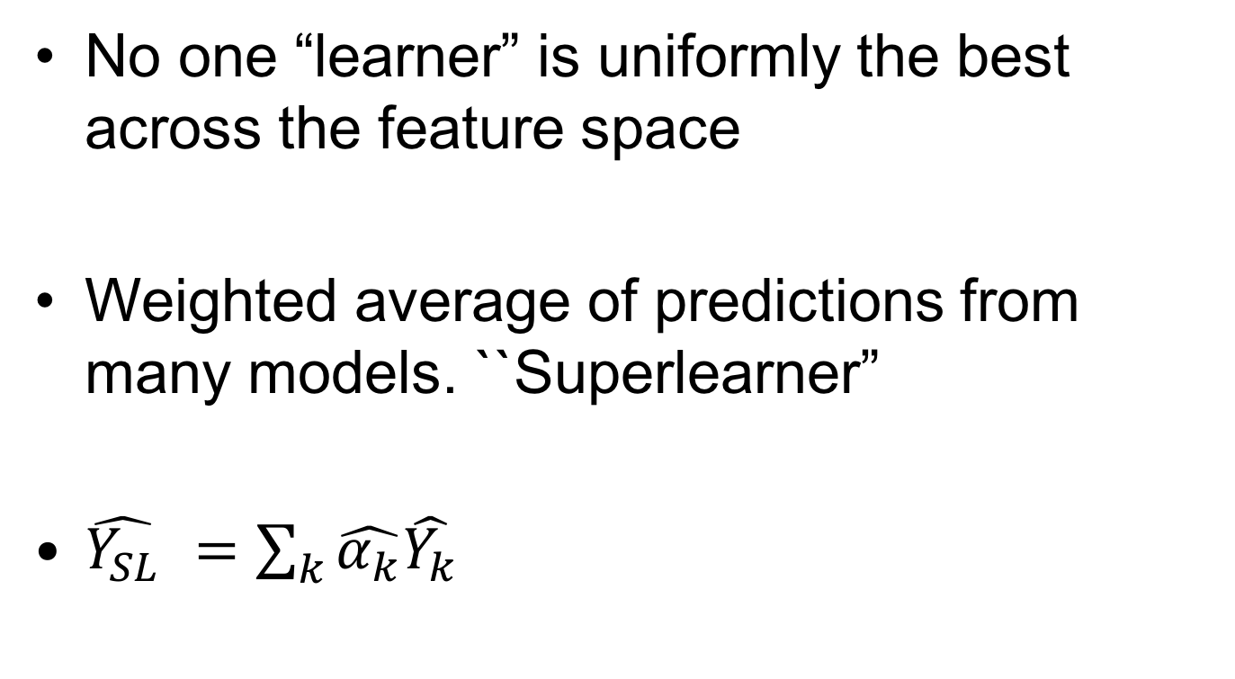
Ensemble Learning

Slide 64
How to choose/estimate the optimal weights?
Again resort to cross-validation
Asymptotically optimal with a convex combination of predictions and a bounded loss function (Polley and vam der Laan, 2011)
Similar to the idea of stacking used in Neural Networks

Slide 65
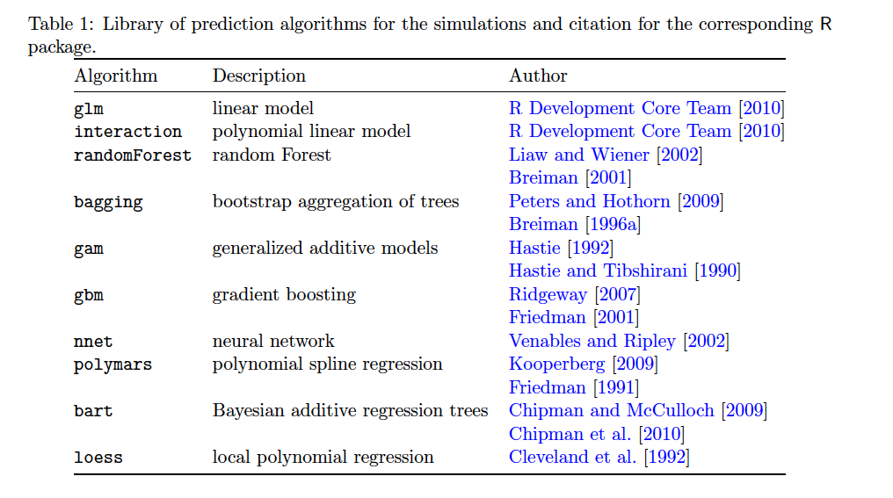
Library of learners

